Slide 1
Please sit near the front :)

Slide 2
Competitive Cyber Security Organization
General - WiFi Hacking
By attending today’s meeting you acknowledge that you may be photographed or recorded for club use

Slide 3
Learning Objectives:
Introduction to Wireless & Safety brief
Equipment Overview
Antenna Theory and Background
Bluetooth Overview w/ Apple_Bleee demo
Wifi Attack Activity
Wifi Attack Scenarios

Slide 4


Introduction to Wireless
Offensive and Defensive Wifi & Bluetooth
Goals:
Learn how to do RF Safely
Teach the right tool for the job
Provide a solid base to learn from

Slide 5
Disclaimer
This course has been designed to teach you Wireless Cyber Warfare, these actions are only to be performed under orders from your direct command channels and within the associated title authorities that you have been provided. We will be teaching real hacking TTPs in a controlled environment.
Outside of your approved duties it is illegal in most countries, especially the U.S., to connect to, decrypt traffic from, penetrate, or inject packets into any Wi-Fi network or any network where you do not have explicit written permission and signed consent given to you by the rightful owner. (We will discuss RoE)
YOU are solely responsible for any and all of the actions that your computer or computing device performs and you assume the consequences of those actions. If you are unsure of how a tool will react please research, test, and/or ask for help.

Slide 6

Activities to Avoid
Jamming transmissions
Overtly transmitting in an area that is supposed to be a safe house or quiet zone or campus
Any offensive actions or transmissions
Interaction with any hardware that you DO NOT OWN (your ISP prob owns your home equipment)

Slide 7
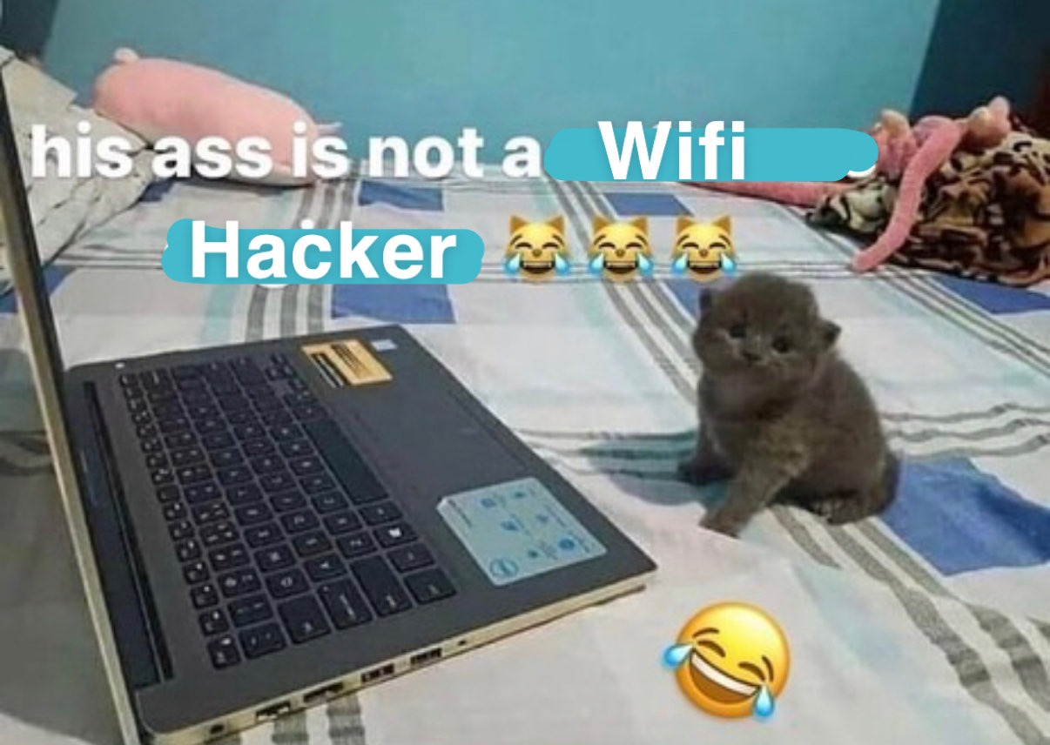
Getting Hands On
Setting Up Our Environment

Slide 8

Pentuwu?
It’s very well maintained for radio work
It’s current and uses all of the best tools for the job
It’s based on Gentoo which is a very efficient Linux variant

Slide 9
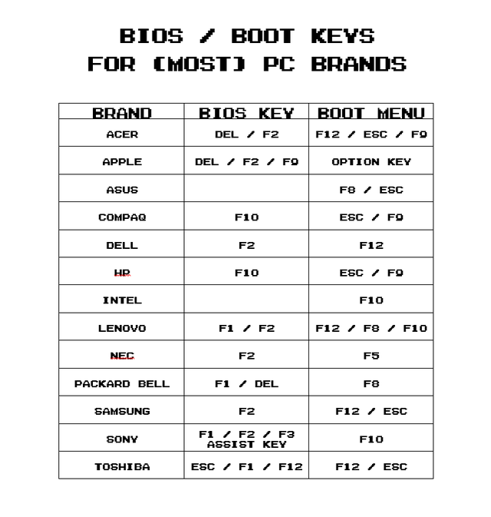
Booting from USB
Insert USB
Escape to BIOS
Select Boot from USB

Slide 10
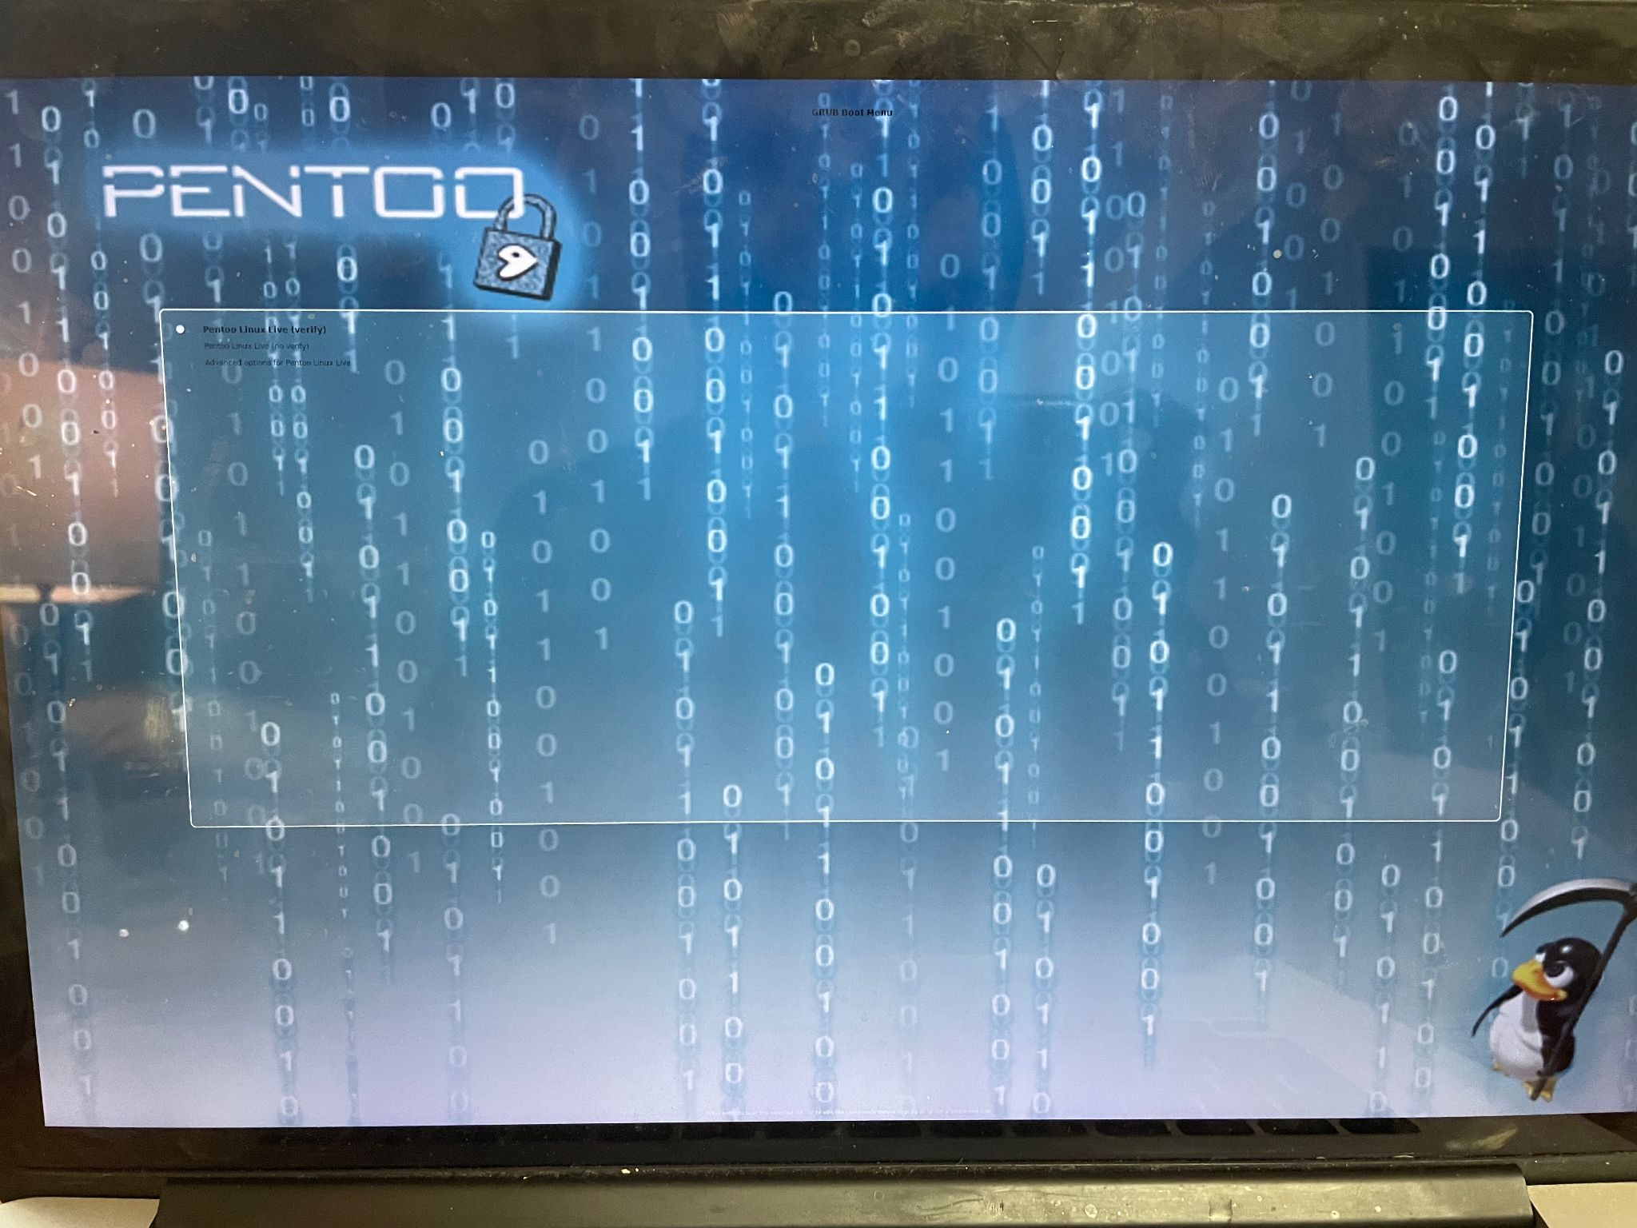

Slide 11
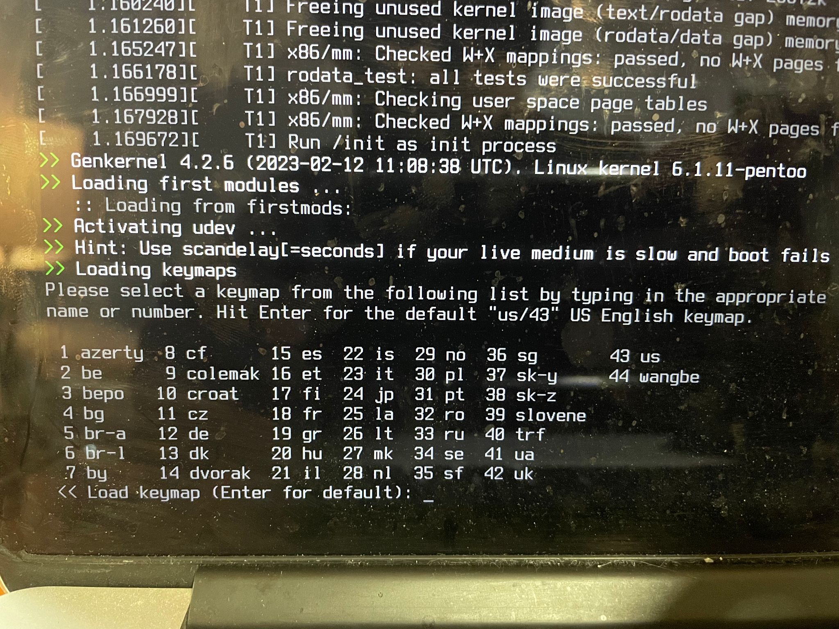

Slide 12
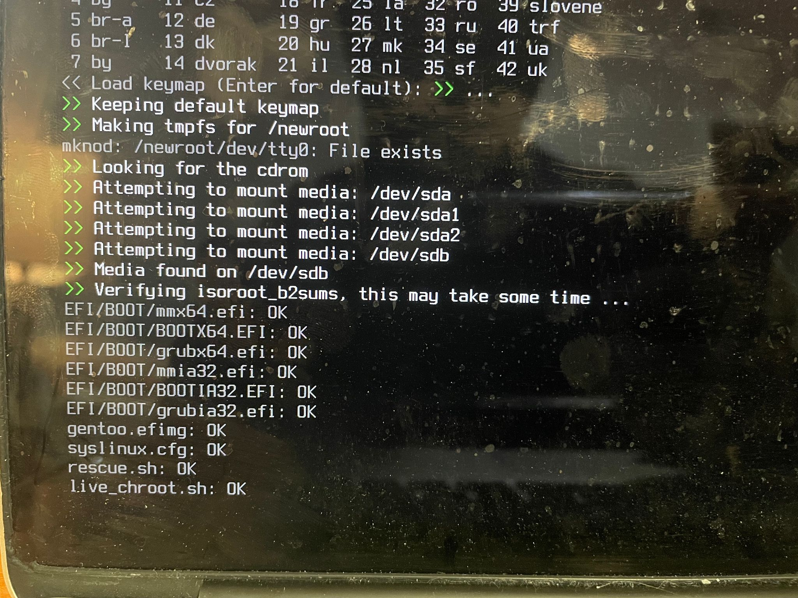

Slide 13
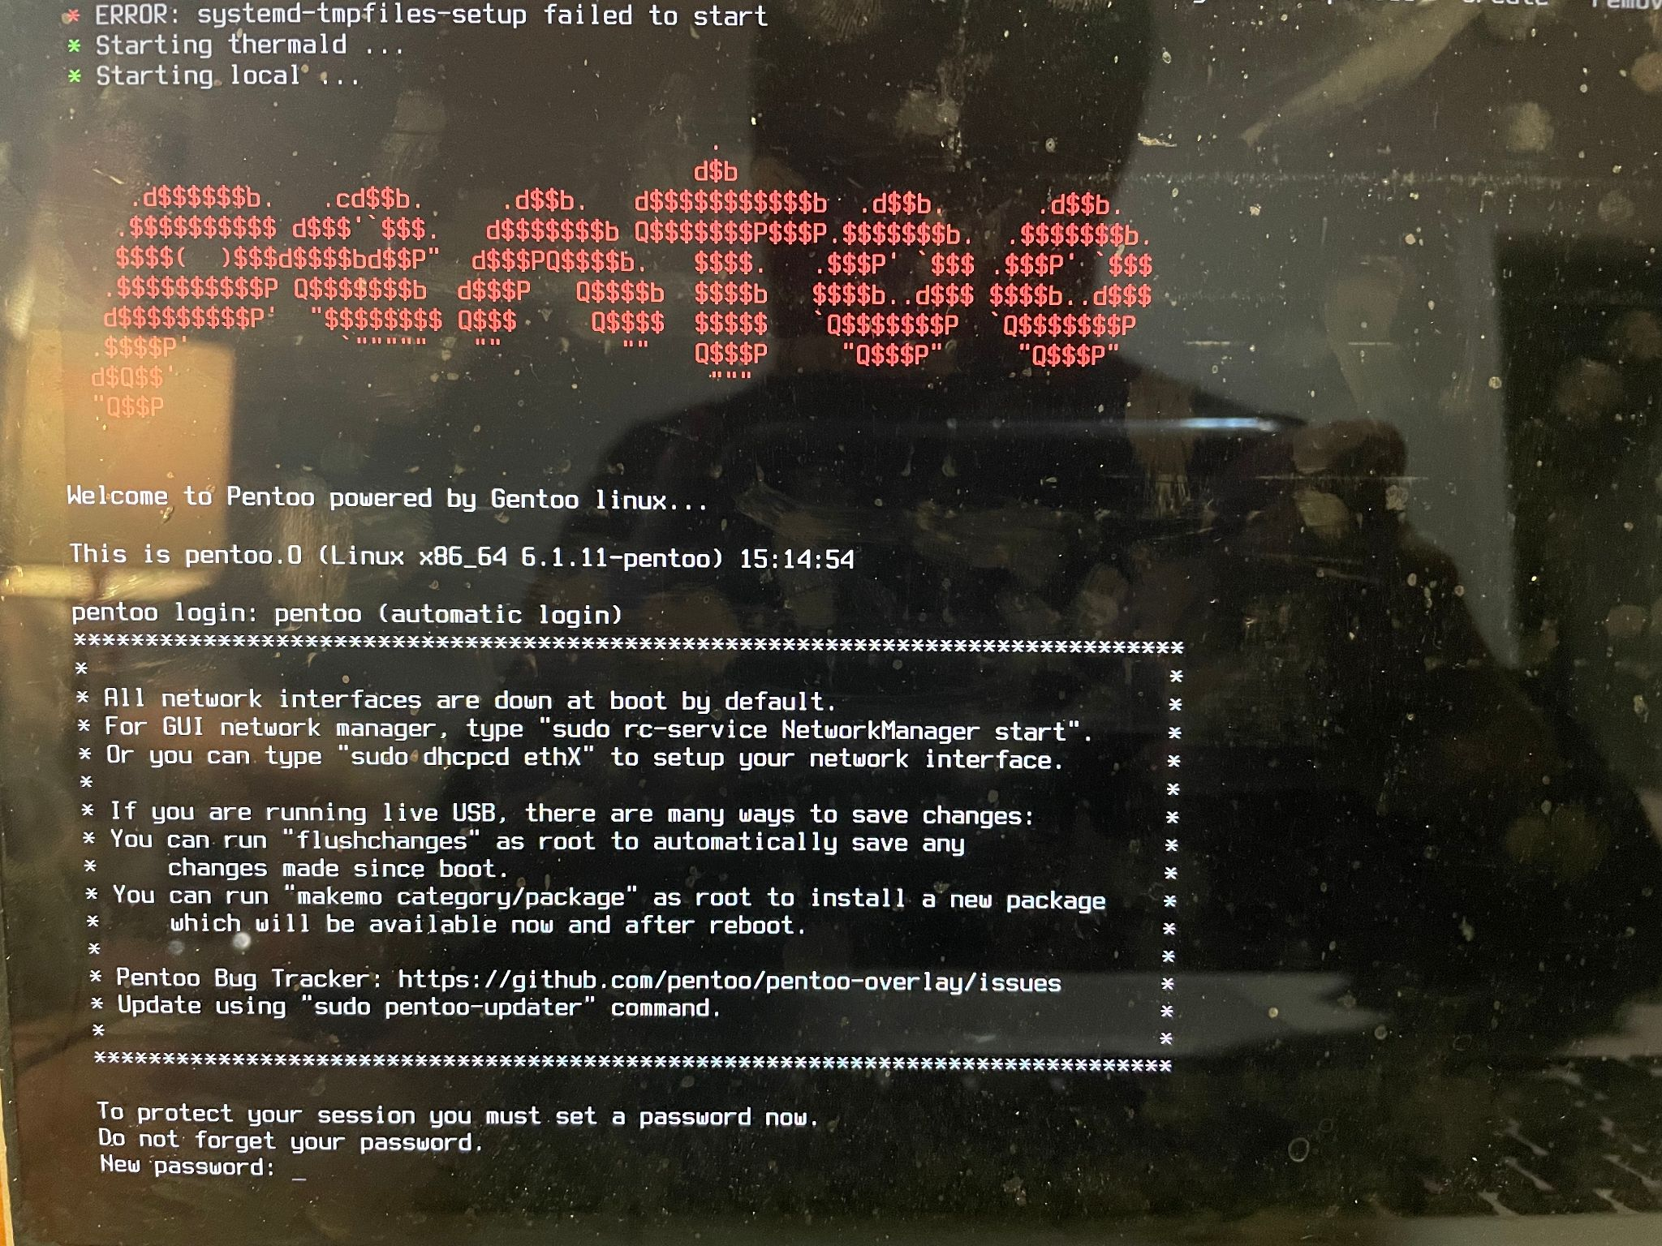

Slide 14
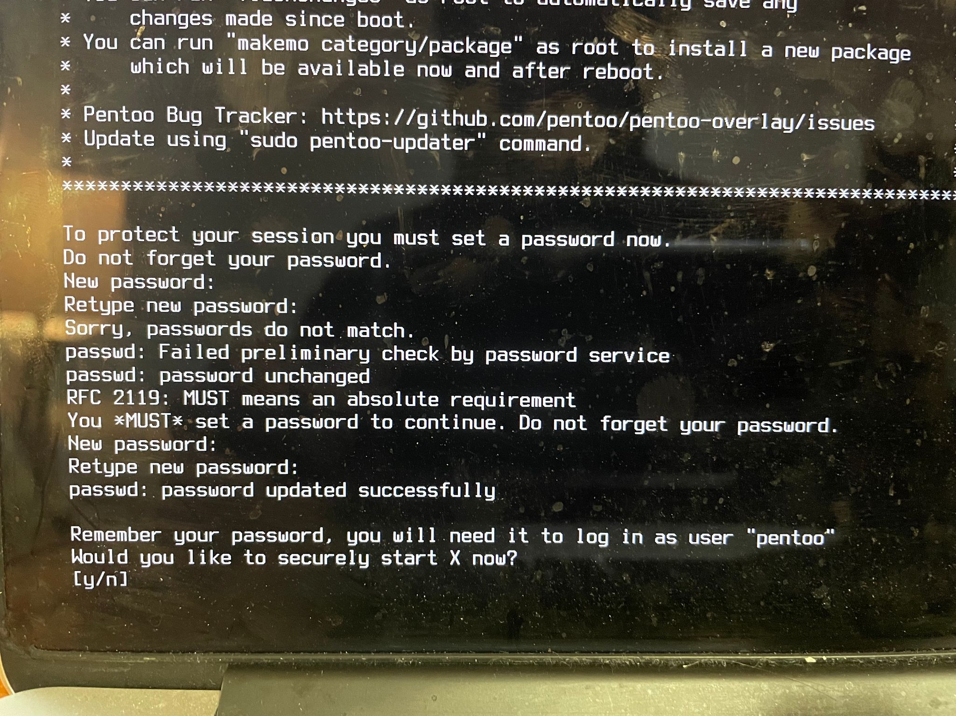

Slide 15
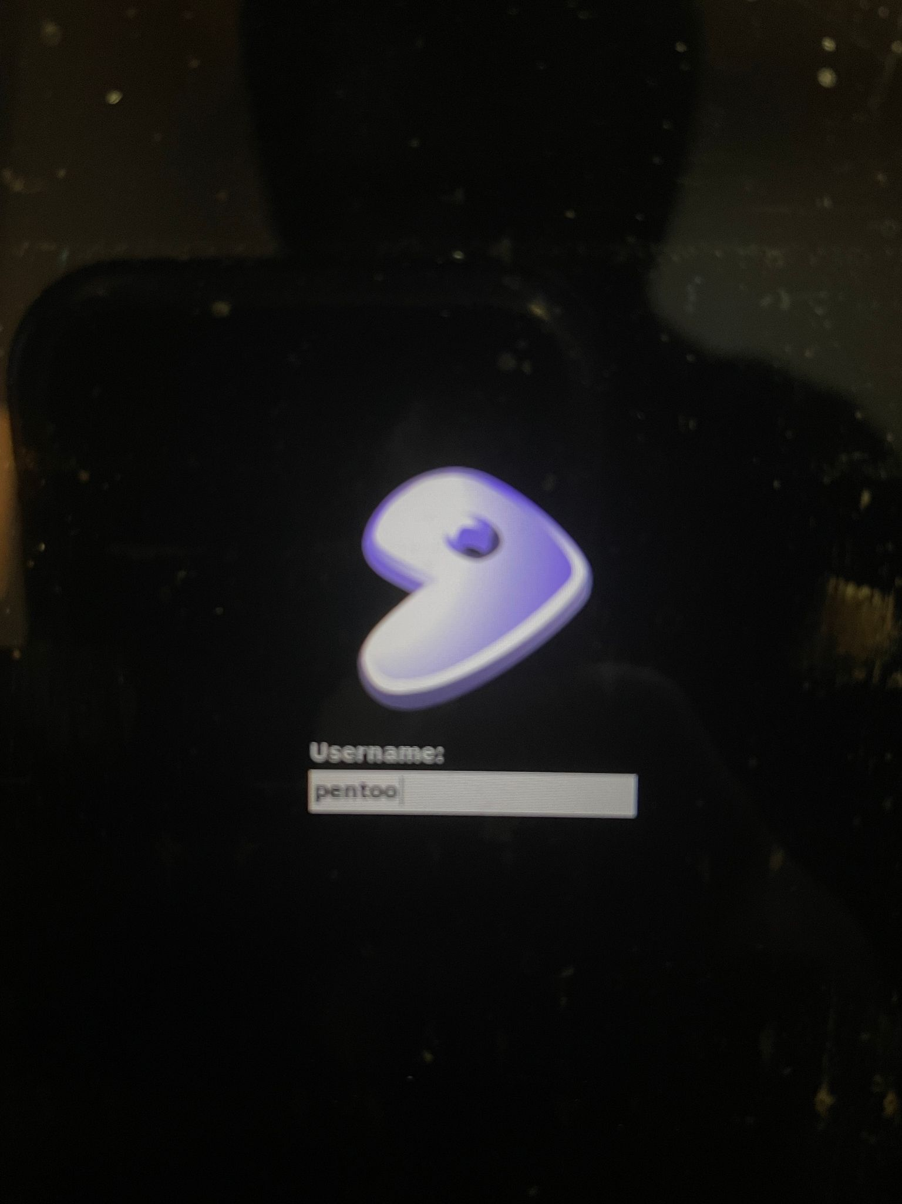
LOGIN
Username: pentoo
Password: **YOU JUST SET**

Slide 16
Starting Networking Services
All networking services are off at boot to keep you quiet
To enable networking:
sudo su -
/etc/init.d/NetworkManager start
To enable any other service such as ssh or bluetooth
/etc/init.d/[service] start

Slide 17
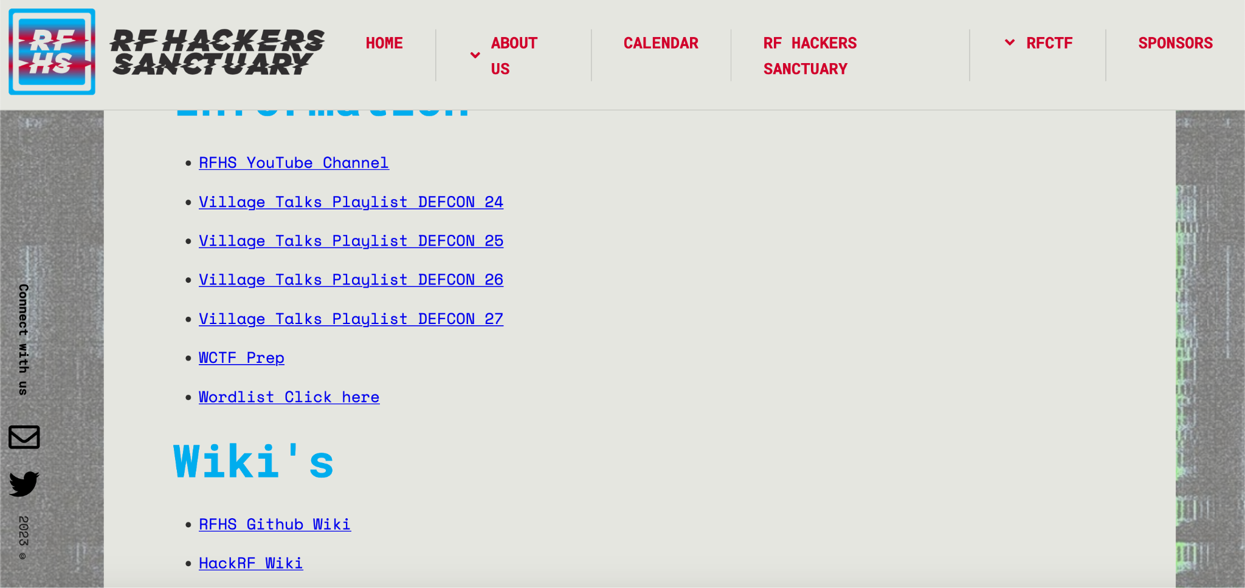
WORDLIST PLS
https://github.com/rfhs/rfctf-files/tree/master/wordlist

Slide 18
Equipment
Wifi:
Alfa AWUS036H - 2G
Alfa AWUS1900 – 2G & 5G
AWUS036AC – 2G & 5G
Bluetooth:
Ubertooth One
Any USB Bluetooth adaptor

Slide 19

Wireless Theory
Hmmmmmmm thonk

Slide 20
Background
802.11X is the standard that governs WiFi
A, B, G, N, AC, AX etc…
2.4 vs. 5 GHz frequencies
Wireless Attenuation
Signal dampens with distance and objects

Slide 21
Wireless Definitions
SSID - Service Set Identifier
Your wireless network name
Human readable
Can be disabled, but still discoverable
BSSID -Basic Service Set Identification
AP identification by MAC Address
ESSID - Extended Basic Service Set
ESSID share the same SSID & BSSID

Slide 22
Encryption Types
WEP
Though worthless for encryption, still useful as identifying a “private” network
WPA
PSK (version 1)
Easily broken with Rainbow Tables
Enterprise (version 2)
Uses Dynamic Key Exchanges + Stronger Encryption

Slide 23
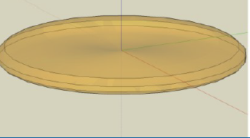
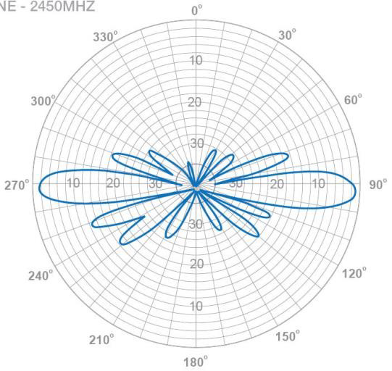
Antenna Types
Omnidirectional - Radiates “equally” in all directions (horizontal)
Semi directional - Radiates stronger signal in certain directions
Directional - Radiates a much stronger signal in one direction

Slide 24
Bluetooth

Slide 25
Bluetooth Protocol
Channel Hopping
UHF from 2.4 to 2.485 GHz
Short distance data transfer and PAN
Bluetooth Special Interest Group (SIG)
Notes:
The Bluetooth SIG oversees development of the specification, manages the qualification program, and protects the trademarks.
A manufacturer must meet Bluetooth SIG standards to market it as a Bluetooth device.

Slide 26
Bluetooth Low Energy (BTLE)
Built for: healthcare, fitness, beacons, security, and home entertainment
Reduced power and cost
Similar range
Ex. Airtags, Fitbits, smart watches

Slide 27
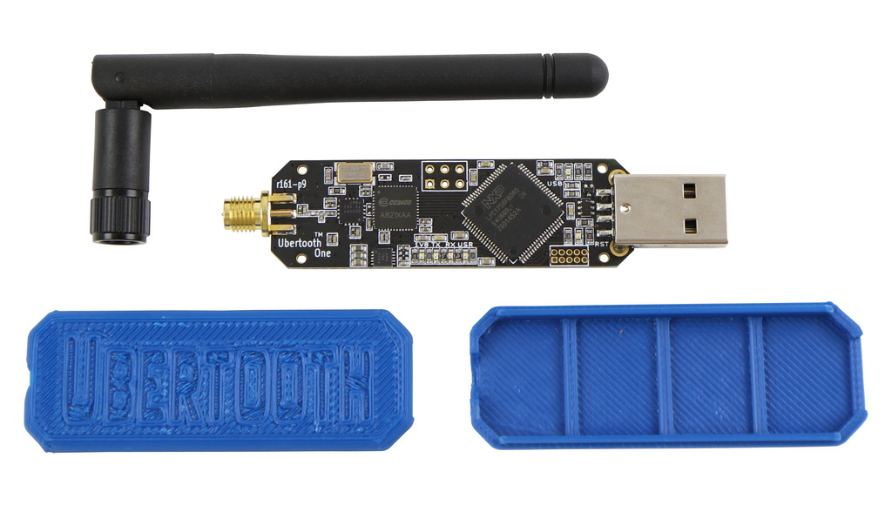
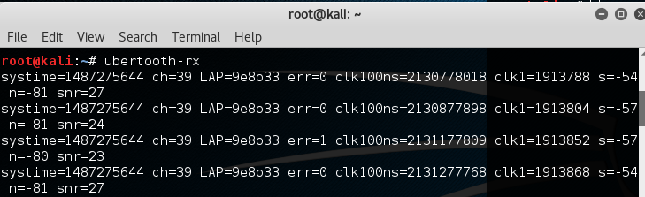
WTF is an Ubertooth
Not a bluetooth adaptor
Can sniff BT and BTLE traffic
Improved antenna capabilities

Slide 28

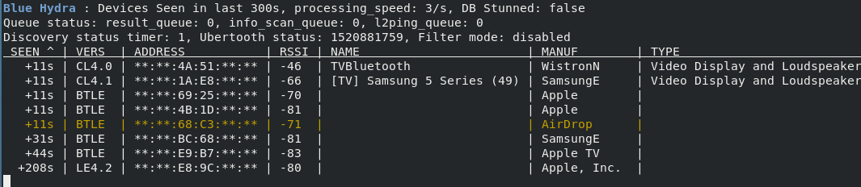
Blue_hydra
ID devices in proximity
BT, BTLE
Red->Green->White

Slide 29
Blue_Sonar
Track single device
L2ping
Destructive...

Slide 30
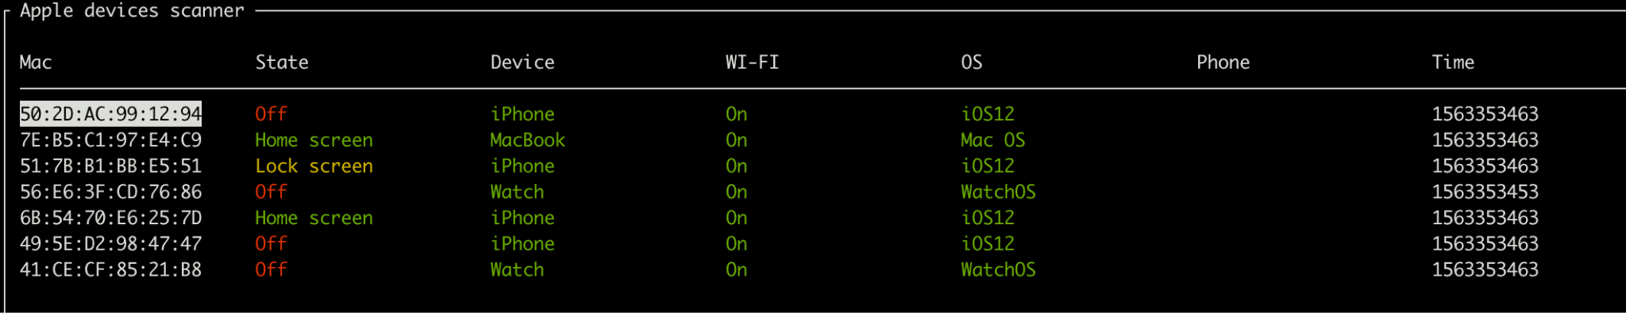
Apple_bleee
Information gathering against Apple
IPhones, Apple Watch, Airpods, Apple TVs
Phone Number??

Slide 31
Wifi Attack Activity

Slide 32
Wifi Listenin
Get some situational awareness
$ airodump-ng <interface>
Notes:
The Bluetooth SIG oversees development of the specification, manages the qualification program, and protects the trademarks.
A manufacturer must meet Bluetooth SIG standards to market it as a Bluetooth device.

Slide 33
Airodump-ng
Time to tune to just what we want
$ airodump-ng –c 11 --manufacturer –w ccso_ctf <interface>

Slide 34
Kismet
Wow Airodump is old :/
Kismet new deal
Tcpdump w/ LEO
$ kismet

Slide 35
MDK3
Murder Death Kill
V4
WIPS/WIDS
Notes:
Murder Death Kill 3/4
Better than aircrack
WIPS/WIDS ….

Slide 36
Time to crack
Get the wordlist!!
https://github.com/rfhs/rfctf-files/tree/master/wordlist
Aircrack!!!
aircrack-ng -w words.txt *.cap

Slide 37
Wifi Attack Scenarios
When ur gonna use this

Slide 38
Wat attacks
WEP AP/ Client only
WPA AP/ Client only
WPA2 AP/ Client only
802.11r/w/rw - ???
802.11ac
Hidden SSID
Notes:
The Bluetooth SIG oversees development of the specification, manages the qualification program, and protects the trademarks.
A manufacturer must meet Bluetooth SIG standards to market it as a Bluetooth device.

Slide 39
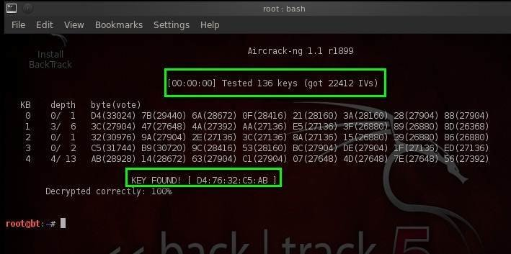
WEP AP/Client
Capture IVs
Get Wordlist
Aircrack
Notes:
Find, ID, Fake Auth, Collect IVs, Replay, Crack
Entropy Failure, all IVs exhausted over 5hr
Will fail w/ wordlist and enough IVs

Slide 40
WPA(2) AP/Client
Deauth
Arpreplay
Aircrack
PSK = Pre-shared key
PMK = Primary master key (Pwn)
PMK = Passphrase + SSID
Notes:
Nice and simple
TKIP – same vulns use AES
Capture Association
Find, ID, Collect, Deauth, Catch, Crack

Slide 41
WPA(2) Client Only
What do you do when no AP??
Hostapd or airbase-ng??
Notes:
Fake an access point

Slide 42
802.11r/w/rw
802.11r = Fast BSS Transition
Half handshake
802.11w = Management Frame Protection
Combat Deauth
802.11rw = Really hard to crack

Slide 43
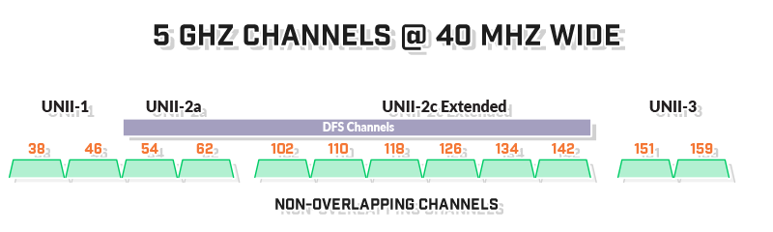
802.11ac == 5 GHz
Same attacks different adaptor

Slide 44
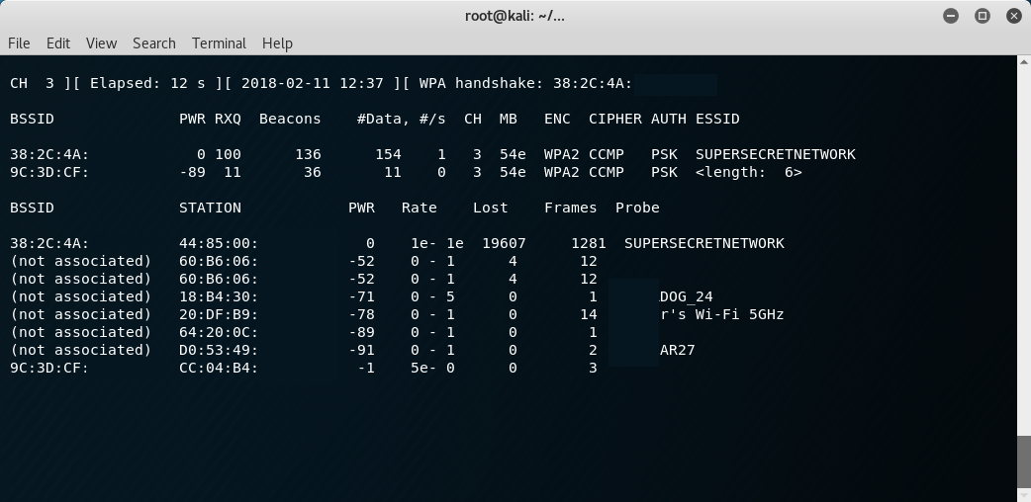
Hidden SSID
V Spooky
People need SSID to connect

Slide 45

CTF Time
Woot woot woot

Slide 46
Resources
https://www.wirelessvillage.ninja/resources
https://github.com/rfhs/rfhs-wiki/wiki
https://www.youtube.com/c/RFHackersSanctuary

Slide 47

CTFd
Login to: ctf.psuccso.org
Login with CCSO
Login with Discord (bit.ly/ccso-discord)
Browse to challenges
Get jiggy wit it

